Slide 1


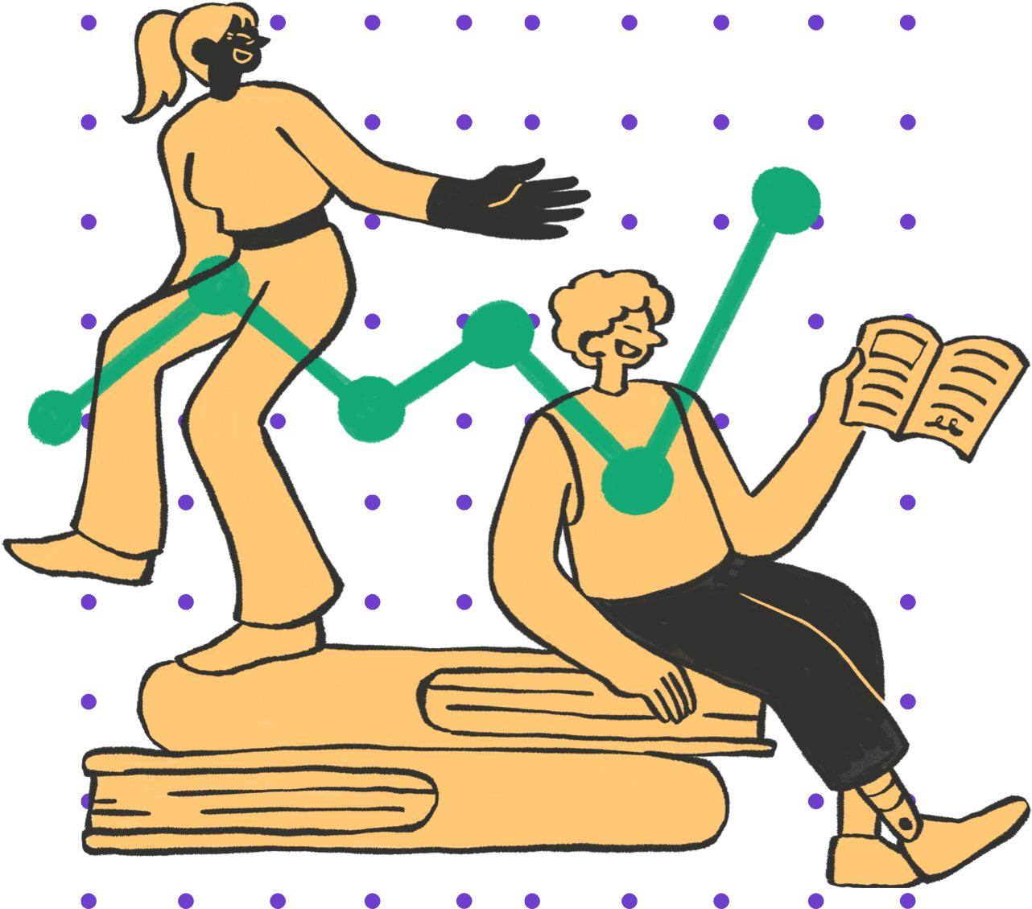

Bellabeat Case Study
Enhancing Marketing Strategy with Data Analysis
Marshall Stordock

Slide 2


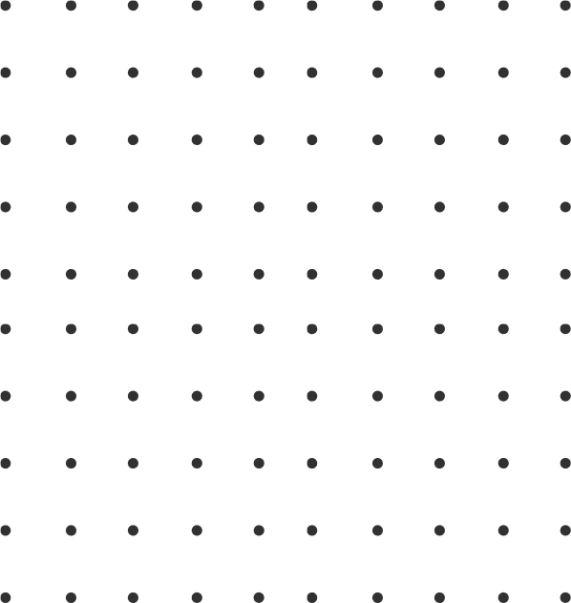


Company
Bellabeat, a high-tech company that focuses on women's health.
I’m Marshall and my objective is to analyze the data from a smart device to gain insights that will improve Bellabeats’ marketing and customer satisfaction.

Slide 3


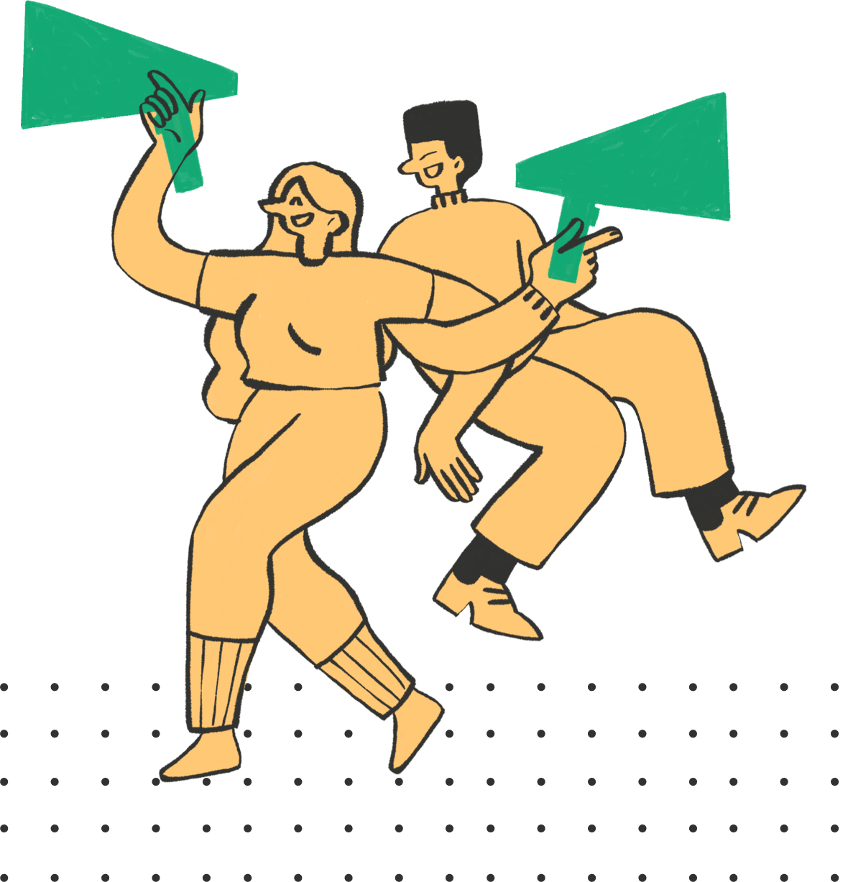
01
01
Introduction
Analyze smart device data to gain insights that will help improve Bellabeat's marketing strategy.

Slide 4


The Task
Analyze data from wearable devices to identify trends and patterns.
Goals:
Understand user behavior and preferences.
Provide actionable insights for the marketing team.
Improve customer engagement and product positioning.
Key Questions
Are there any correlations and trends within the selected data?
How does this data apply to Bellabeat's customers?
How will the findings help the marketing team improve their strategy?

Slide 5
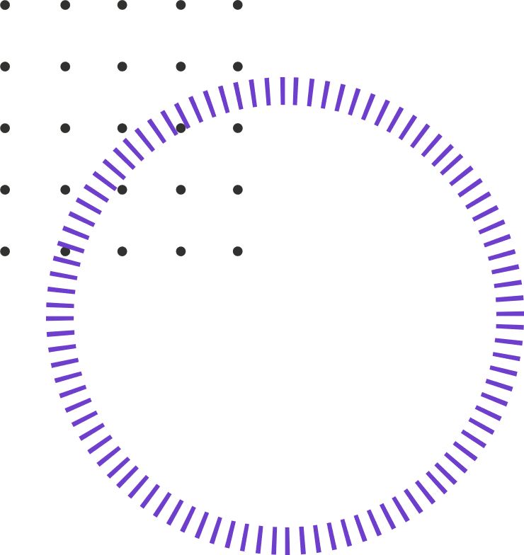
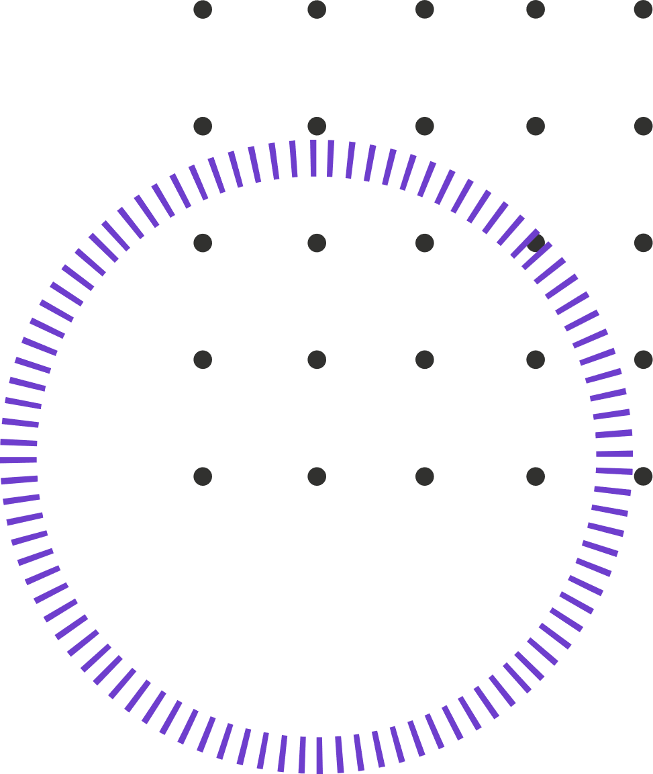
Data Overview
FitBit Tracker Data Collected from 03/12/2016 to 05/12/2016
Datasets Used:
hourly_steps
daily_activity
daily_sleep
Tools Used:
Google Sheets
R
Limitations:
Small sample size
Limited demographic information.
Short data collection period

Slide 6

Data Cleaning Process
# Removing duplicates and N/As
hourly_steps <- hourly_steps %>%
distinct() %>%
drop_na()
daily_activity <- daily_activity %>%
distinct() %>%
drop_na()
daily_sleep <- daily_sleep %>%
distinct() %>%
drop_na()
# Verifying duplicate removal
sum(duplicated(daily_sleep))
Duplicate Removal
Null Value Removal
# Looking for Duplicates
sum(duplicated(hourly_steps))
sum(duplicated(daily_activity))
sum(duplicated(daily_sleep))
# Looking for Nulls
sum(is.na(hourly_steps))
sum(is.na(daily_activity))
sum(is.na(daily_sleep))
Date/Time Format
# Cleaning date-time format for daily_sleep and daily_activity for merging later
daily_activity <- daily_activity %>%
rename(date = activitydate) %>%
mutate(date = as_date(date, format = "%m/%d/%Y"))
daily_sleep <- daily_sleep %>%
rename(date = sleepday) %>%
mutate(date = as_date(date,format ="%m/%d/%Y %I:%M:%S %p" , tz=Sys.timezone()))
# Converting hourly_steps to date-time format
hourly_steps<- hourly_steps %>%
rename(date_time = activityhour) %>%
mutate(date_time = as.POSIXct(date_time,format ="%m/%d/%Y %I:%M:%S %p" , tz=Sys.timezone()))
head(hourly_steps)
Column Formatting
# Cleaning and Renaming columns to lower case
clean_names(hourly_steps)
hourly_steps <- rename_with(hourly_steps, tolower)
clean_names(daily_activity)
daily_activity <- rename_with(daily_activity, tolower)
clean_names(daily_sleep)
daily_sleep <- rename_with(daily_sleep, tolower)

Slide 7

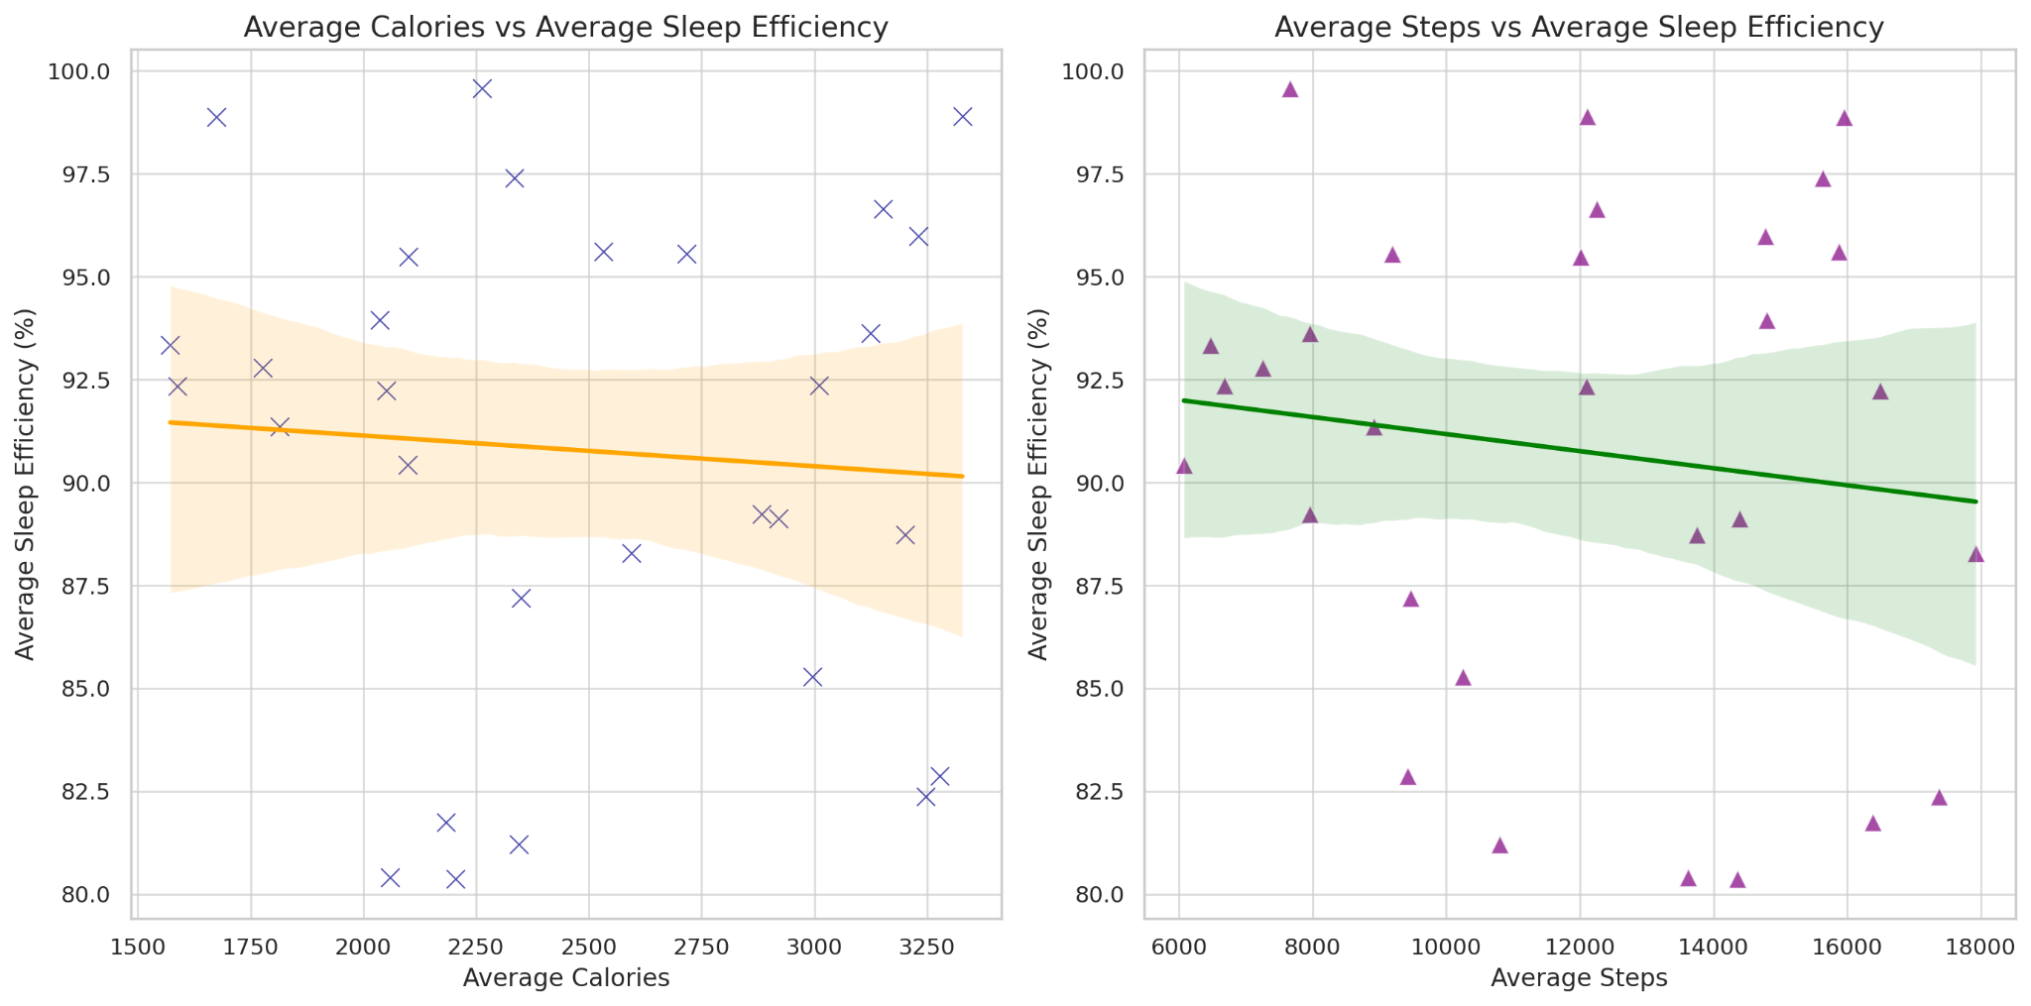

Analysis
Metric for Sleep Efficiency:
Sleep Efficiency = (Total Minutes Asleep / Total Time in Bed) * 100
Analyzed correlations between:
Calories burned and sleep efficiency.
Total steps and sleep efficiency.
Calories and Sleep Efficiency: Positive correlation, indicating active users tend to sleep more efficiently.
Steps and Sleep Efficiency: Weak correlation, suggesting other factors may influence sleep quality beyond step count.

Slide 8


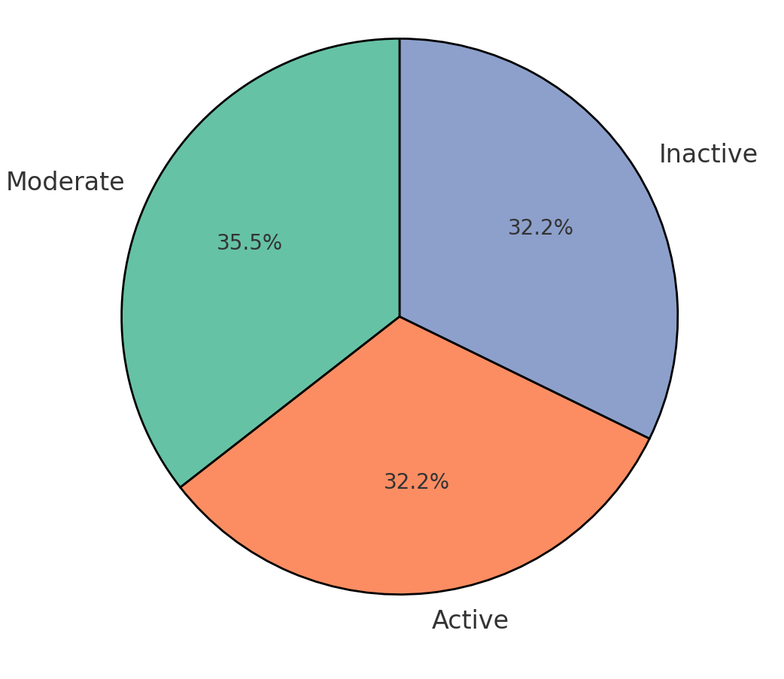


Activity Level Classification
Categorized Users: Active, Moderate, Inactive based on daily steps.
Pie Chart: Shows distribution of user activity levels.
Observation: Balanced distribution across activity levels.
Activity Based on Daily Steps

Slide 9




Recommendations for Marketing
Highlight Sleep Efficiency as a Wellness Point:
Use sleep efficiency as a core feature in campaigns to appeal to wellness-focused customers.
Launch Activity-Sleep Challenges:
Encourage users to improve sleep through increased activity levels.
Educational Campaigns:
Inform customers on the benefits of physical activity for sleep quality.
Jane Doe
Mary Smith
John Doe
Elaborate on what you want to discuss.
Elaborate on what you want to discuss.
Elaborate on what you want to discuss.

Slide 10
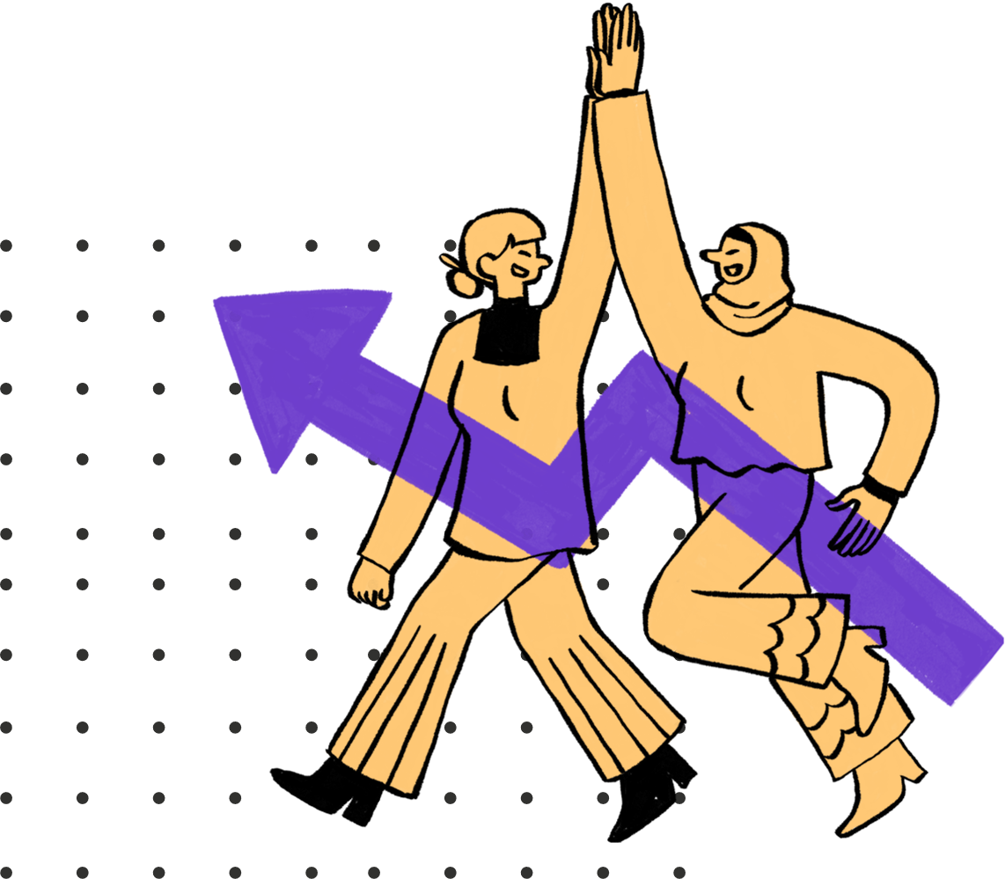
Conclusion
Summary of Insights:
Analysis:
Calories and Activity Impact Sleep: The data analysis shows that users with higher calorie burn tend to have better sleep efficiency, reinforcing the connection between physical activity and improved rest.
Targeted Marketing Potential: With a diverse user base in terms of activity levels, Bellabeat has the opportunity to personalize its marketing approach for different segments (Active, Moderate, Inactive).
Importance of Holistic Wellness: By focusing on holistic wellness metrics like sleep efficiency, Bellabeat can appeal to its health-conscious audience.
Key Takeaway:
Bellabeat should position itself as a holistic wellness brand by emphasizing the value of balanced physical activity for better sleep and overall health. The insights gained from this case study highlight a data-driven approach to improve user engagement and product positioning.
Call to Action:
Encourage Bellabeats’ teams to implement these insights in their marketing and product development strategies to better meet the needs of their target audience.

